Slide 1
SDI FY18 Task 3 – Inverse Modeling in Model Calibration
2018-11-2

Slide 2
Task 3: Test the use of inversed models in the model calibration process
Workflow:
Identify an EnergyPlus model (a DOE reference model or a real building model)
Conduct traditional model calibration and record performance
Use the hybrid method in the calibration
3.1. Initial calibration using traditional approach
3.2. Run inversed models to determine unknown parameters
3.3. Use the calculated parameters from 3.2 in the traditional calibration and re-run it.
3.4. Repeat this process as needed.

Slide 3
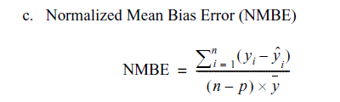

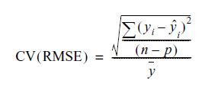
Success Criteria
Model uncertainty criteria (ASHRAE Guideline 14)
Normalized Mean Bias Error (NMBE )
Coefficient of Variation of the Root-Mean-Square-Error (CV[RMSE])
According to ASHRAE Guideline 14: “The computer model shall have an NMBE of 5% and a CV(RMSE) of 15% relative to monthly calibration data. If hourly calibration data are used, these requirements shall be 10% and 30%, respectively.”

Slide 4
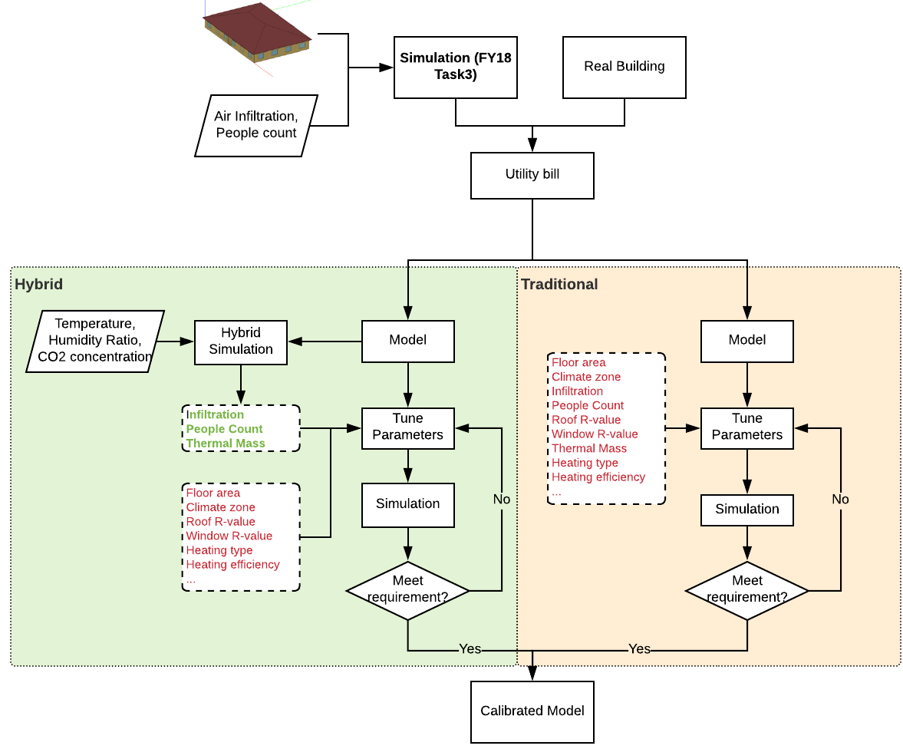
Task 3: Test the use of inversed models in the model calibration process
Compare:
Numbers of unknown parameters
Numbers of iterations
Calibrated model accuracy (ASHRAE G14)
Cases:
Manual
Hybrid

Slide 5
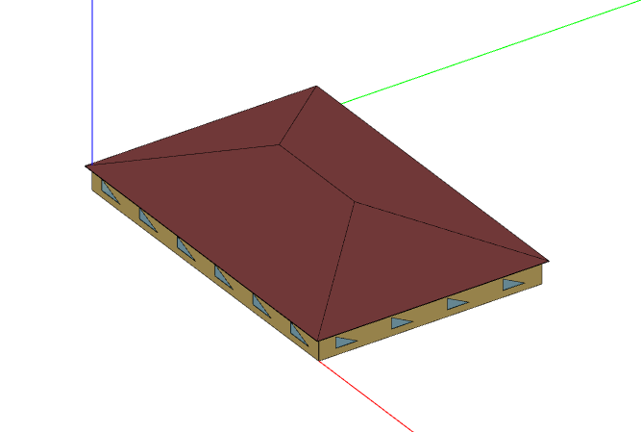
Model settings
1. Model
Baseline model (uncalibrated)
Virtual ground truth model (target)
Tuned model (calibrating)
2. Location:
Pittsburgh
3. Model feature
5-zone small office building model created from CBES Pro
Demand controlled ventilation

Slide 6
Steps of Inverse Modeling in Model Calibration
1. Run normal simulation with the virtual ground truth model to get:
Virtual zone air temperature measurements
Virtual zone air humidity ratio measurements
Virtual zone air CO2 concentration measurements
2. Hybrid simulation with the uncalibrated model and virtual measurements to get:
Inverse solution of zone people count (hourly schedule)
Inverse solution of zone air infiltration rate (hourly schedule)
3. Update the original schedules of the uncalibrated model:
Substitute the old number of people schedule with the inverse solution
Substitute the old air infiltration rate schedule with the inverse solution
4. Run normal simulation with the updated uncalibrated model (model under calibration)
5. Compare the results between the monthly energy consumption of the model under calibration and the ground truth

Slide 7
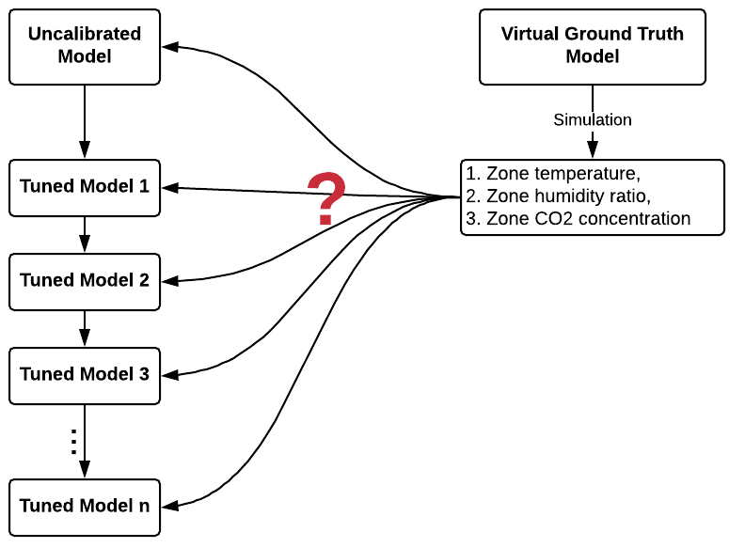
Hybrid Calibration
Question: which step to use inverse modeling?

Slide 8
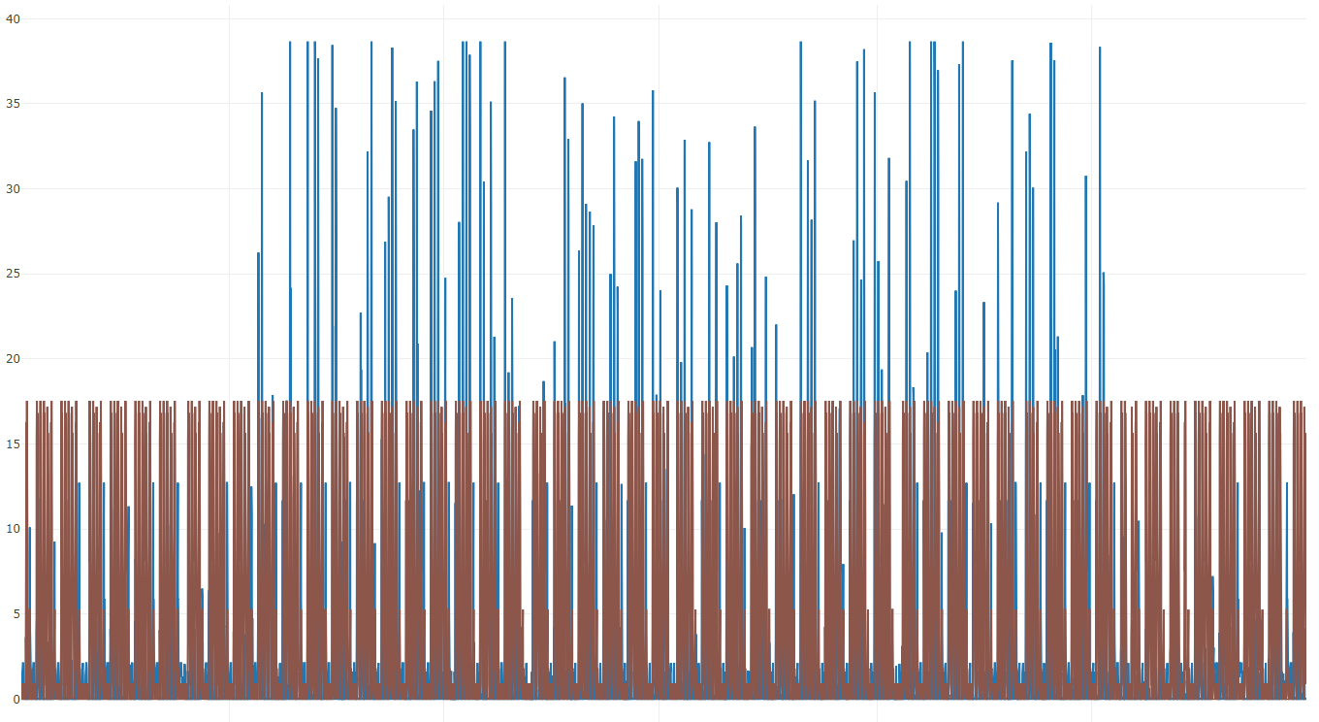
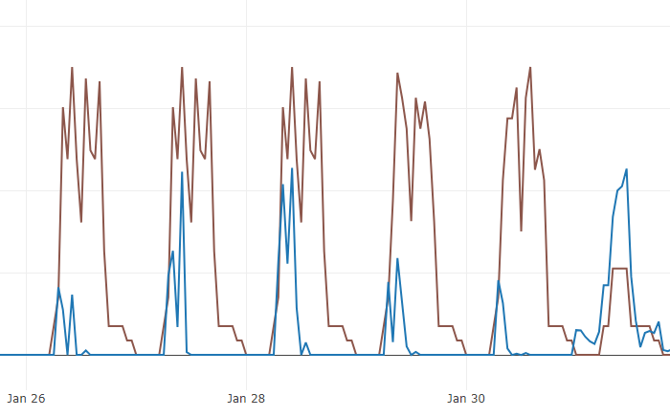
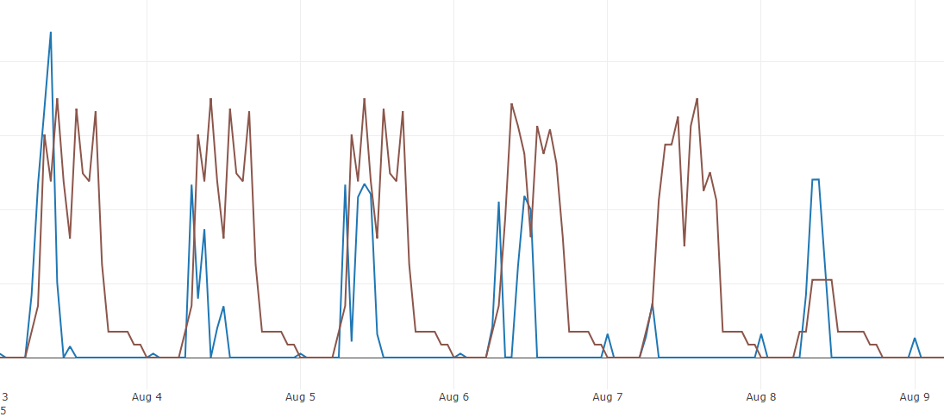
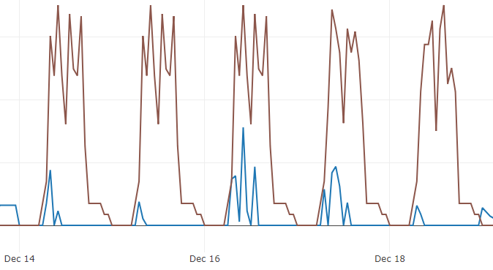
Hybrid Calibration - using inverse modeling in early steps
Inverse solution of people count vs ground truth
Annual
A week in January
A week in August
A week in December
Inverse Solution
Ground Truth
* Charts show the solution with measured air temperature, the solution with measured CO2 concentration is similar

Slide 9
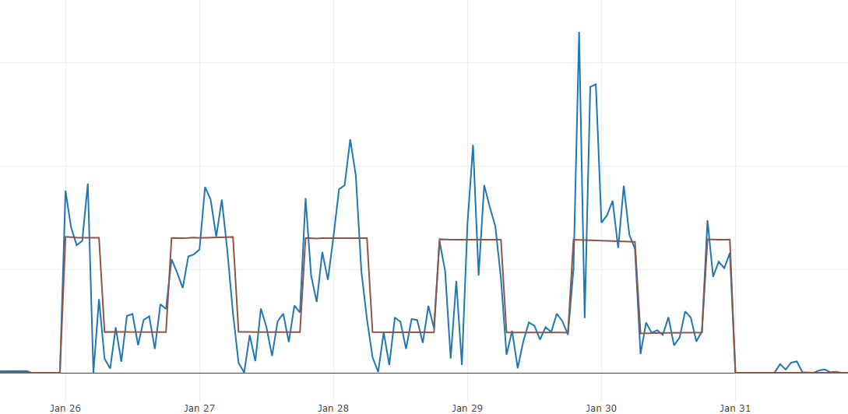
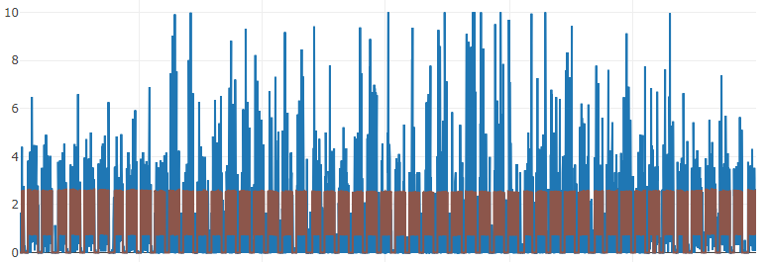
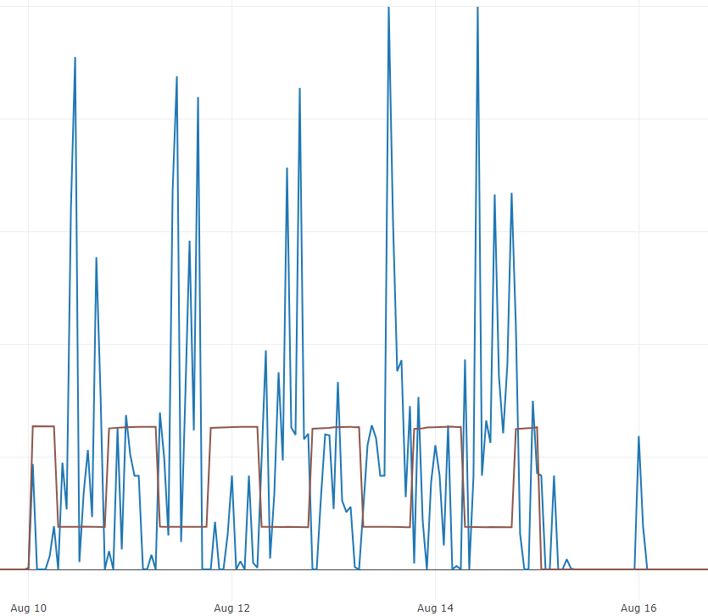
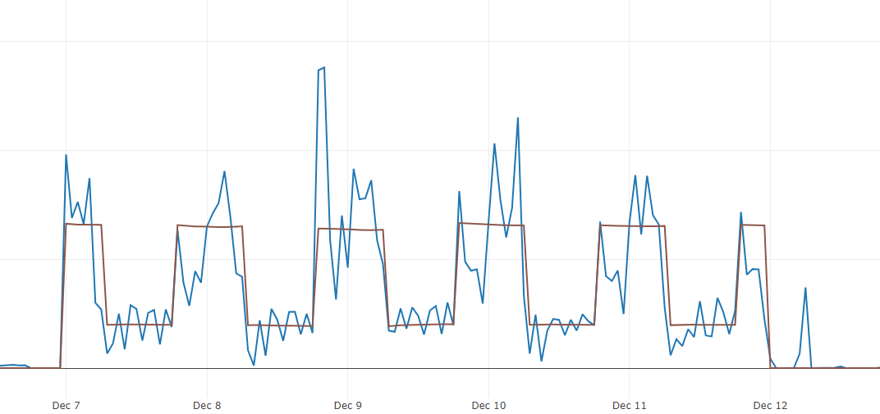
Hybrid Calibration - using inverse modeling in early steps
Inverse solution of air infiltration vs ground truth
Annual
A week in January
Inverse Solution
A week in August
A week in December
Ground Truth
* Charts show the solution with measured air temperature, the solution with measured CO2 concentration is similar

Slide 10
Hybrid Calibration - using inverse modeling in early steps
Finding: inverse modeling in early stage of the model calibration cannot get accurate people count and air infiltration schedules.
Reason: parameters other than people count and air infiltration are uncertain.
?
?
?
$$ρ_{air}V_{z}C_{T}\frac{dT_{z}}{dt}=\sum_{i}{Q_{i}}+Q_{occ}+\sum_{i}{h_{i}A_{i}}ρ_{air}\left(T_{si}−T_{z}^{t}\right)+\sum_{i}{{\dot{m}}_{i}}C_{p}\left(T_{zi}−T_{z}^{t}\right)+{\dot{m}}_{inf}C_{p}\left(T_{o}−T_{z}^{t}\right)+\sum_{i}{Q_{sys}}$$
?
?
?
$$ρ_{air}V_{z}C_{W}\frac{dW_{z}}{dt}=\sum_{i}{M_{W,in}}+M_{W, occ}+\sum_{i}{h_{mi}A_{i}}ρ_{air}\left(W_{si}−W_{z}^{t}\right)+\sum_{i}{{\dot{m}}_{i}}\left(W_{zi}−W_{z}^{t}\right)+{\dot{m}}_{inf}\left(W_{o}−W_{z}^{t}\right)+\sum_{i}{M_{W,sys}}$$
?
?
$$ρ_{air}V_{z}C_{{CO}_{2}}\frac{dC_{z}}{dt}=\sum_{i}{M_{{CO}_{2},in}}+M_{{CO}_{2},occ}+\sum_{i}{m_{i}}\left(C_{zi}−C_{z}^{t}\right)+{\dot{m}}_{inf}\left(C_{o}−C_{z}^{t}\right)+\sum_{i}{M_{{CO}_{2}, sys}}$$

Slide 11
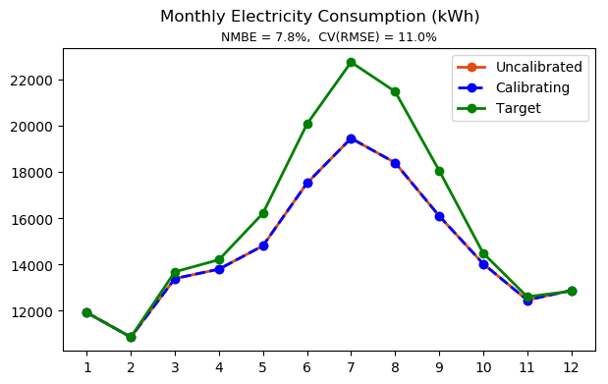
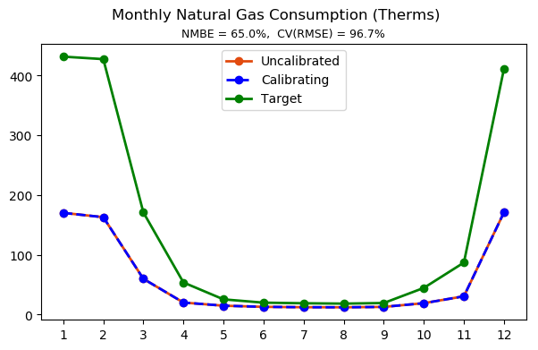
Hybrid Calibration – Manual calibration first
Step zero
* Slide 9 through 23 are the manual calibration steps

Slide 12
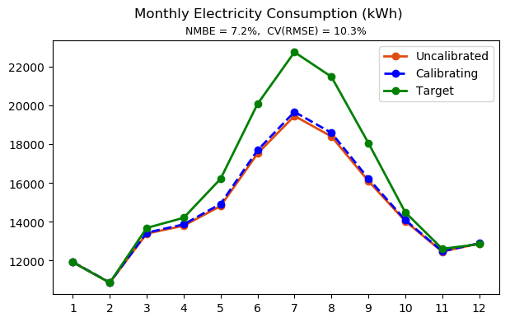
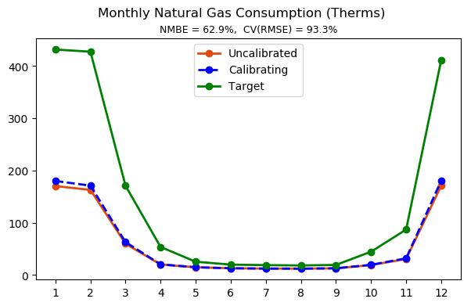
Manual Calibration – manual calibration
Step 1
Exterior wall thermal conductivity x 1.5
Exterior wall thickness x 0.8

Slide 13
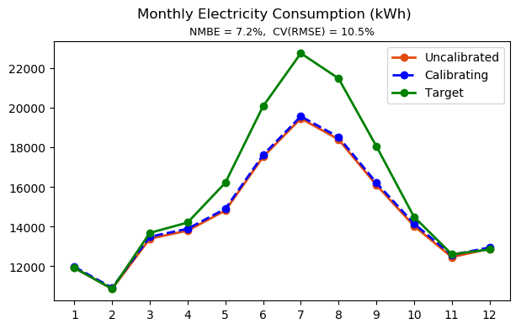
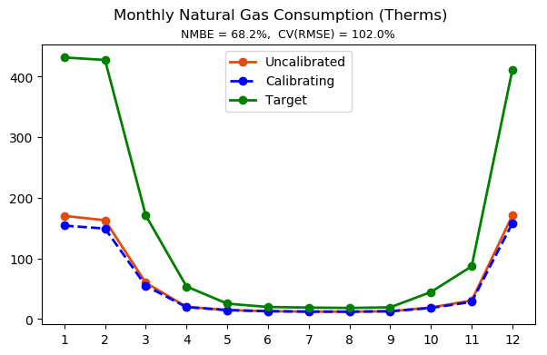
Manual Calibration – manual calibration
Step 2
Exterior wall and floor thermal conductivity x 1.5
Exterior wall and floor thickness x 0.8

Slide 14


Manual Calibration – manual calibration
Step 3
Exterior wall and floor thermal conductivity x 2
Exterior wall thickness x 0.8
Exterior glazing U-factor x 1.2
Exterior glazing SHGC x 0.8

Slide 15
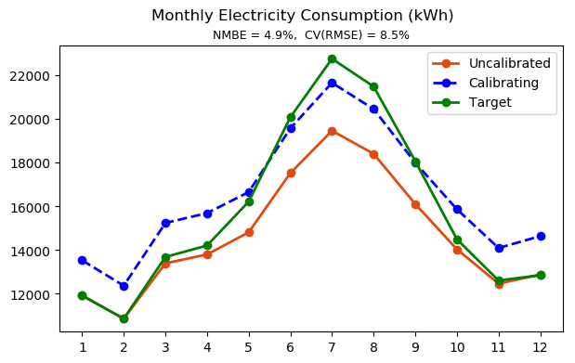
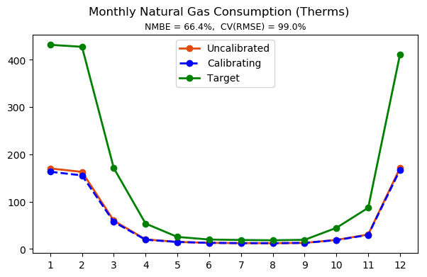
Manual Calibration – manual calibration
Step 4
Exterior wall and floor thermal conductivity x 2
Exterior wall thickness x 0.8
Exterior glazing U-factor x 1.2
Exterior glazing SHGC x 0.8
Interior lighting and equipment power density x 1.2

Slide 16
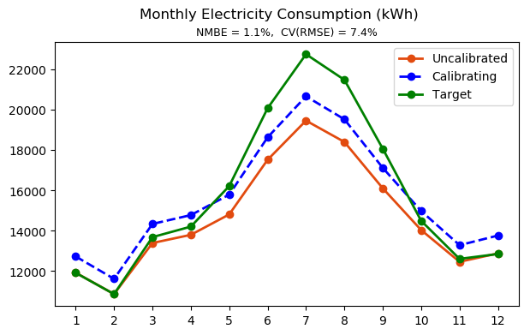
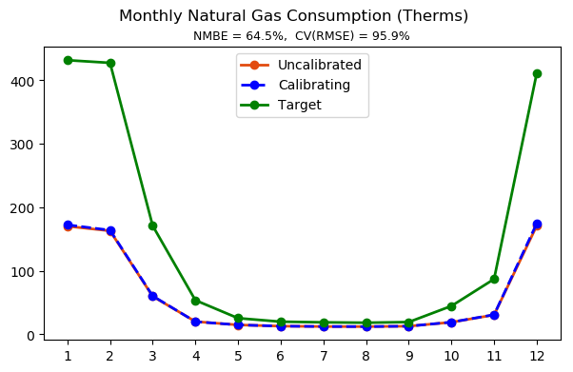
Manual Calibration – manual calibration
Step 5
Exterior wall and floor thermal conductivity x 2
Exterior wall thickness x 0.8
Exterior glazing U-factor x 1.2
Exterior glazing SHGC x 0.8
Interior lighting and equipment power density x 1.1

Slide 17
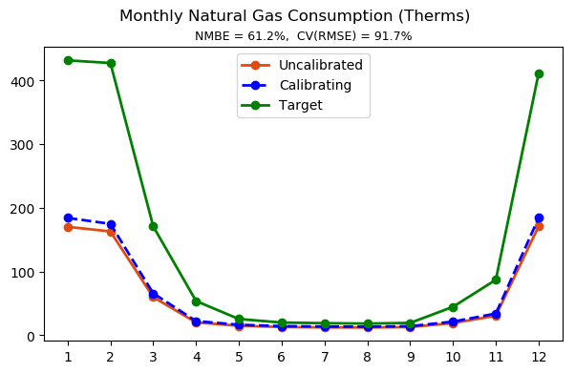
Manual Calibration – manual calibration
Step 6
Exterior wall and floor thermal conductivity x 2
Exterior wall thickness x 0.8
Exterior glazing U-factor x 1.2
Exterior glazing SHGC x 0.8
Interior lighting and equipment power density x 1.1
Boiler and water heater efficiency x 0.9

Slide 18
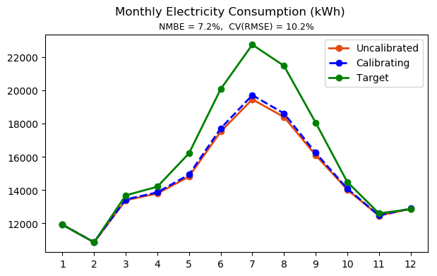
Manual Calibration – manual calibration
Step 7
Exterior wall and floor thermal conductivity x 2
Exterior wall thickness x 0.8
Exterior glazing U-factor x 1.2
Exterior glazing SHGC x 0.8
Interior lighting and equipment power density x 1.1
Boiler and water heater efficiency x 0.9
Chiller COP x 0.9

Slide 19
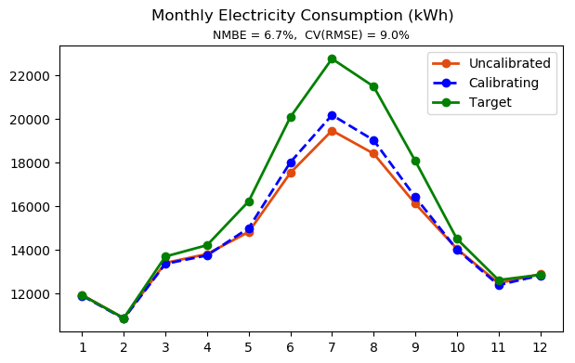
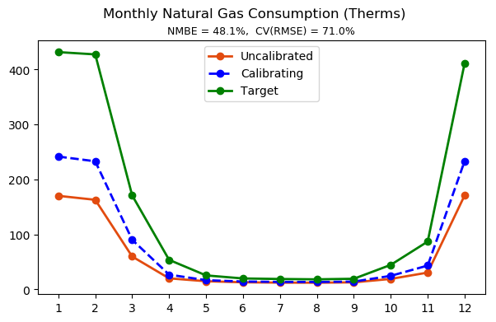
Manual Calibration – manual calibration
Step 8
Exterior wall and floor thermal conductivity x 2
Exterior wall thickness x 0.8
Exterior glazing U-factor x 1.2
Exterior glazing SHGC x 0.8
Interior lighting and equipment power density x 1.1
Boiler and water heater efficiency x 0.9
Chiller COP x 0.9
Occupancy density x 1.5

Slide 20
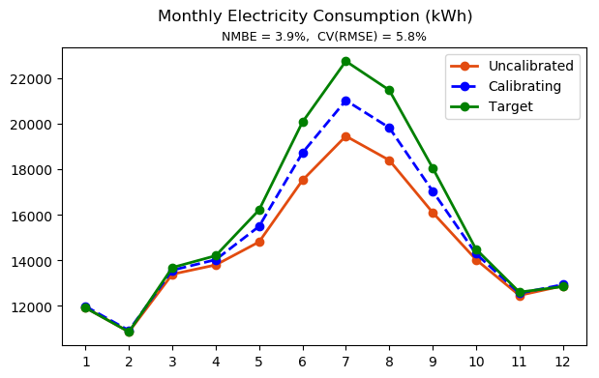
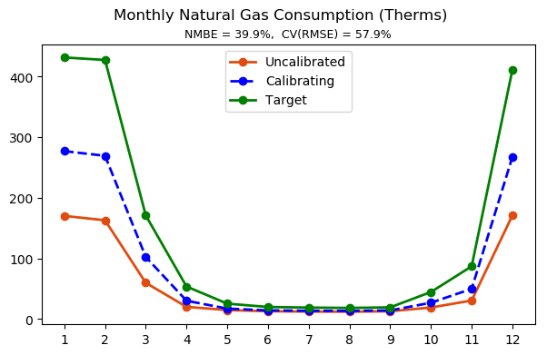
Manual Calibration – manual calibration
Step 9
Exterior wall and floor thermal conductivity x 2
Exterior wall thickness x 0.8
Exterior glazing U-factor x 1.2
Exterior glazing SHGC x 0.8
Interior lighting and equipment power density x 1.1
Boiler and water heater efficiency x 0.9
Chiller COP x 0.9
Occupancy density x 1.5
Infiltration rate x 1.5

Slide 21
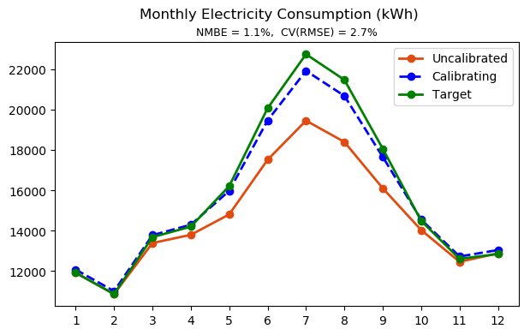
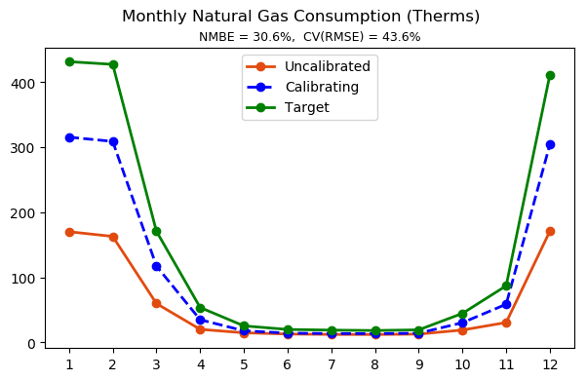
Manual Calibration – manual calibration
Step 10
Exterior wall and floor thermal conductivity x 2
Exterior wall thickness x 0.8
Exterior glazing U-factor x 1.2
Exterior glazing SHGC x 0.8
Interior lighting and equipment power density x 1.1
Boiler and water heater efficiency x 0.9
Chiller COP x 0.9
Occupancy density x 1.5
Infiltration rate x 2

Slide 22
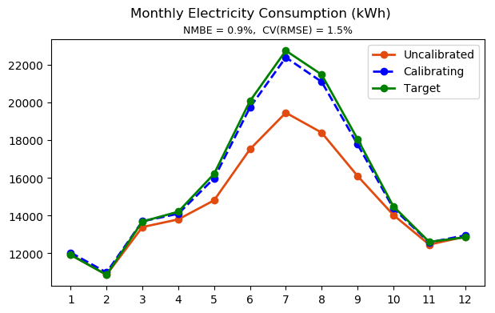
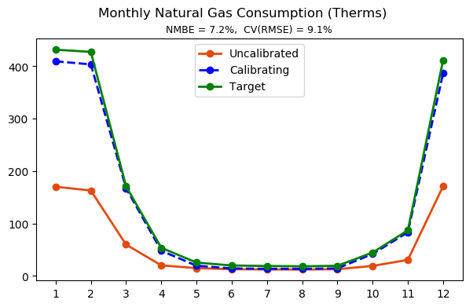
Manual Calibration – manual calibration
Step 11
Exterior wall and floor thermal conductivity x 2
Exterior wall thickness x 0.8
Exterior glazing U-factor x 1.2
Exterior glazing SHGC x 0.8
Interior lighting and equipment power density x 1.1
Boiler and water heater efficiency x 0.9
Chiller COP x 0.9
Occupancy density x 1.5
Infiltration rate x 2
Outdoor air rate per person x 1.5

Slide 23
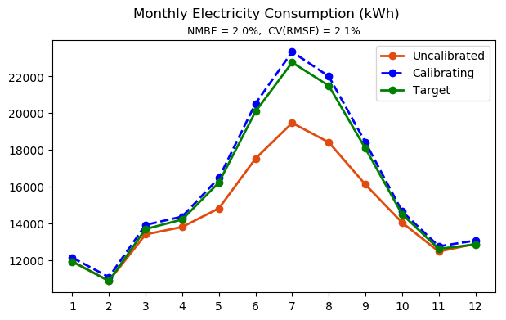
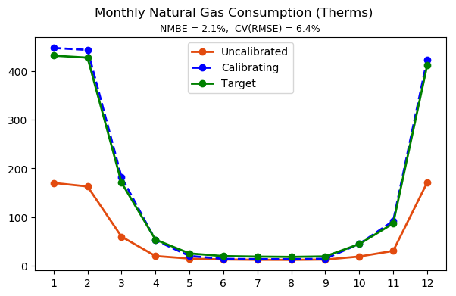
Manual Calibration – manual calibration
Step 12
Exterior wall and floor thermal conductivity x 2
Exterior wall thickness x 0.8
Exterior glazing U-factor x 1.2
Exterior glazing SHGC x 0.8
Interior lighting and equipment power density x 1.1
Boiler and water heater efficiency x 0.9
Chiller COP x 0.9
Occupancy density x 1.5
Infiltration rate x 2.5
Outdoor air rate per person x 1.5

Slide 24
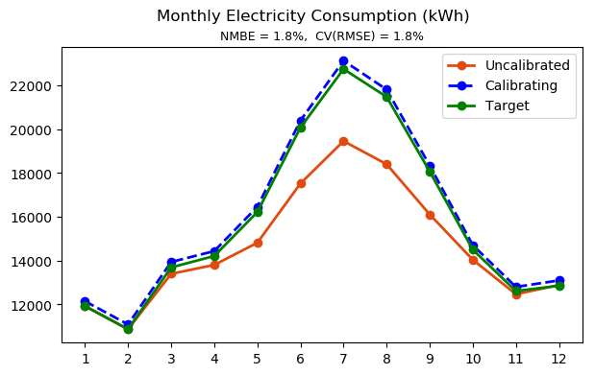

Manual Calibration – manual calibration
Step 13
Exterior wall and floor thermal conductivity x 2
Exterior wall thickness x 0.8
Exterior glazing U-factor x 1.2
Exterior glazing SHGC x 0.8
Interior lighting and equipment power density x 1.1
Boiler and water heater efficiency x 0.9
Chiller COP x 0.9
Occupancy density x 1.5
Infiltration rate x 2.5
Outdoor air rate per person x 1.3

Slide 25
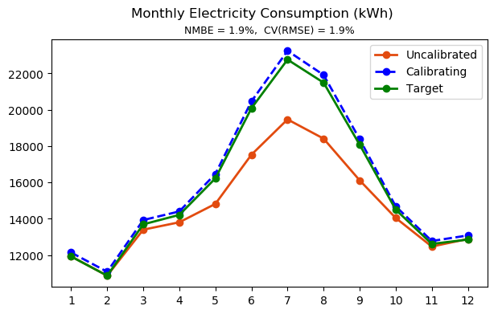
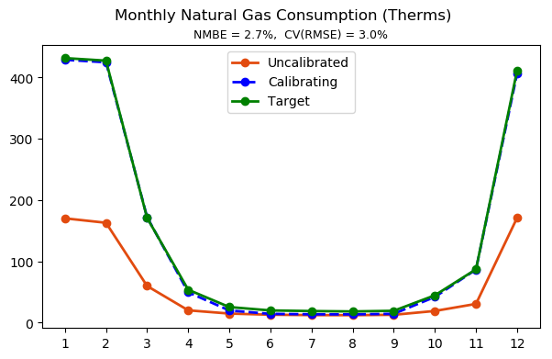
Manual Calibration – manual calibration
Step 14
Exterior wall and floor thermal conductivity x 2
Exterior wall thickness x 0.8
Exterior glazing U-factor x 1.2
Exterior glazing SHGC x 0.8
Interior lighting and equipment power density x 1.1
Boiler and water heater efficiency x 0.9
Chiller COP x 0.9
Occupancy density x 1.5
Infiltration rate x 2.5
Outdoor air rate per person x 1.4

Slide 26
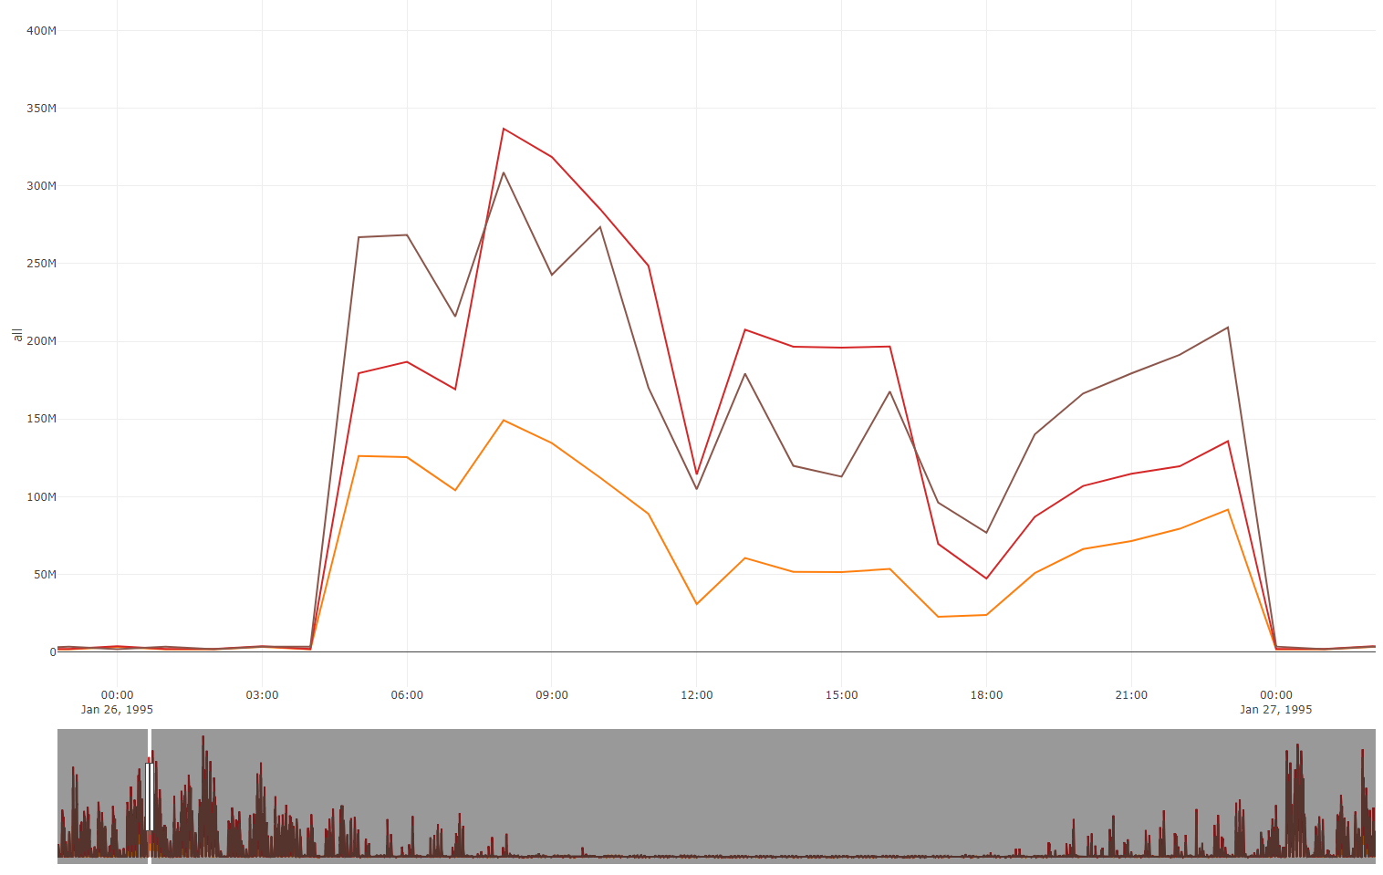
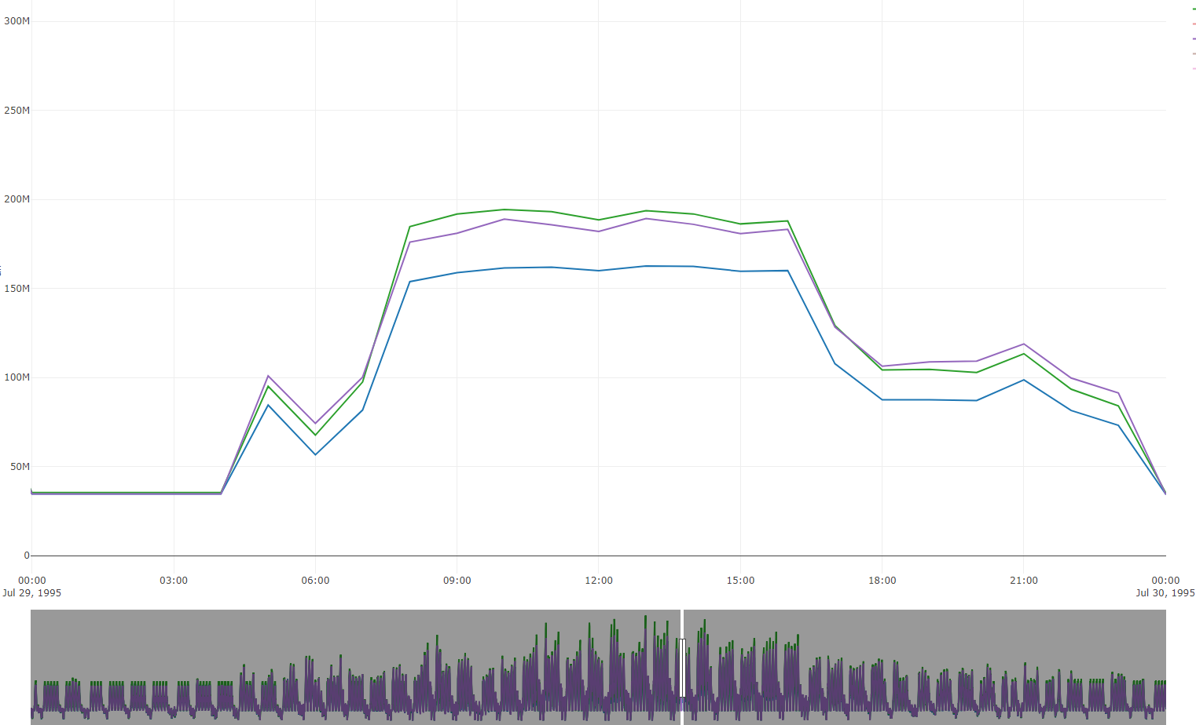
Accuracy at higher resolution
Although the manual model tuning could well calibrate the model at monthly level, it cannot capture the dynamics at more granular time interval.
The reason for the fluctuations of energy consumption is due to the dynamic occupancy schedule.
Hourly electricity consumption in a day (cooling season)
Hourly gas consumption in a day (heating season)
Target (Ground Truth)
Target (Ground Truth)
Calibrated
Calibrated
Uncalibrated
Uncalibrated

Slide 27
Can inverse modeling solve the highly dynamic occupancy and air infiltration schedules with higher resolution?

Slide 28
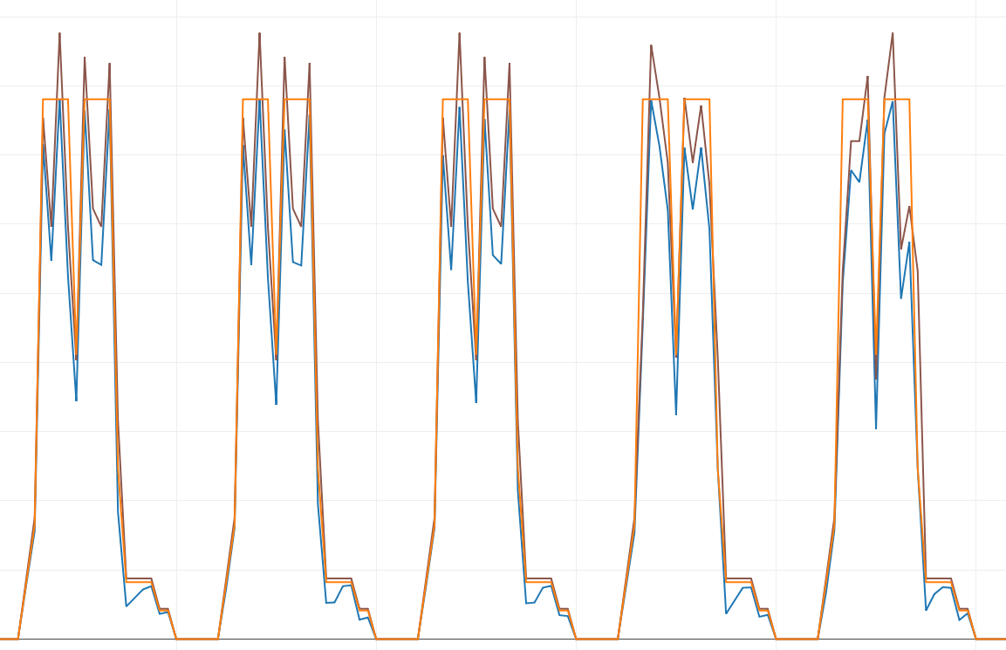
Hybrid Calibration – people count
Example of zone people count schedule.
The inversely solved people count aligns with the ground truth well for both cooling and heating seasons
The maximum values of the inverse solution are smaller than the ground truth, due to model uncertainties.
Ground Truth
Inverse Solution
Baseline
* The plot shows the number people schedule in a perimeter zone (zone back) of a typical week.
* The inverse solution is based on the zone air CO₂ balance equation.

Slide 29
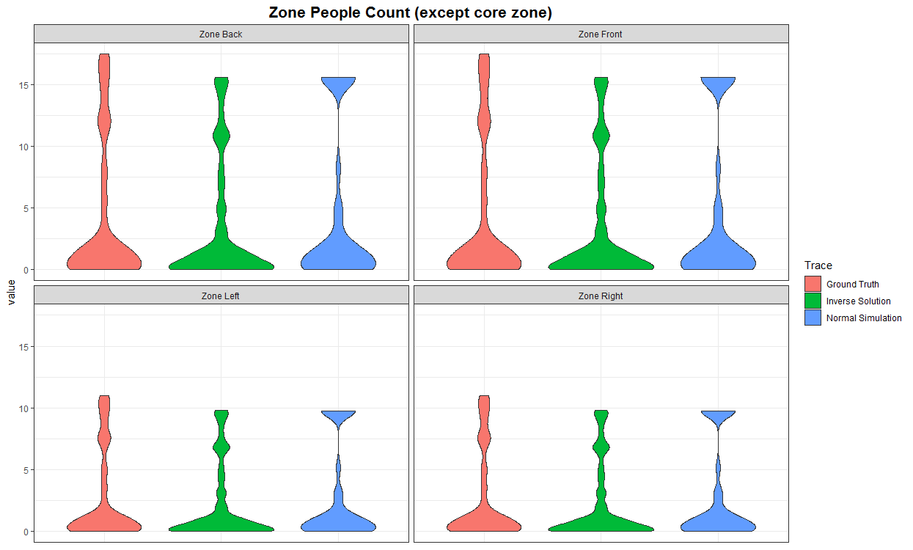
Hybrid Calibration – people count
The inversely solved people count with measured CO2 concentration can capture the dynamics of the ground truth.

Slide 30
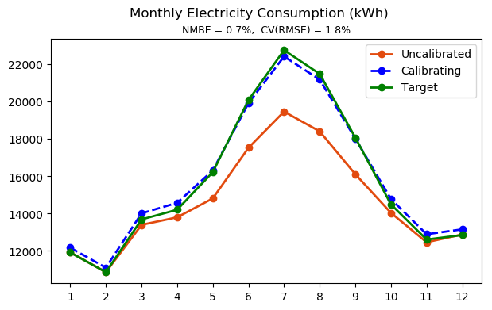

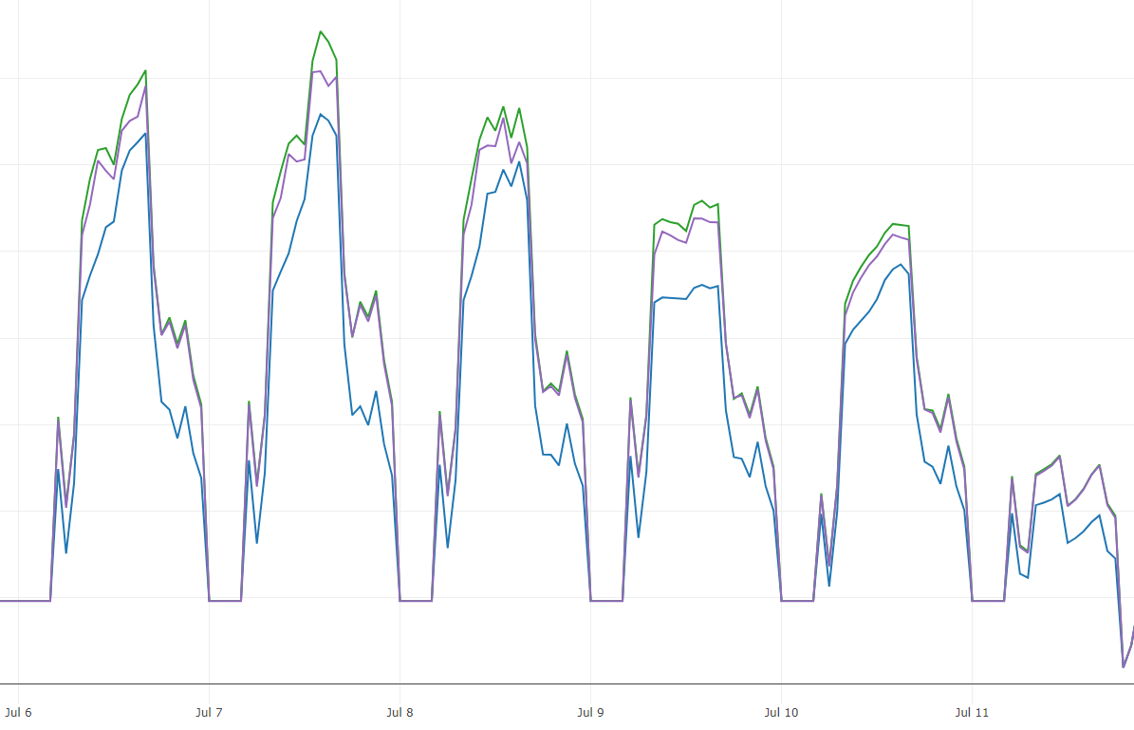
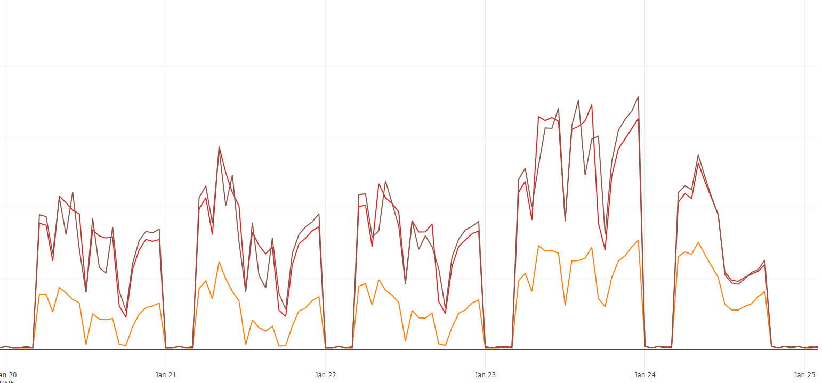
Hybrid Calibration – people count
Gains of the inversely solved people count in model calibration
Accuracy improvements are trivial at the monthly level
Accuracy improvements for electricity at hourly level is small – due to the small impact of occupancy on cooling energy
Accuracy improvements for gas at hourly level is more significant
 | Inverse People Count Schedule | NMBE | CV(EMSE)
Electricity | No | 1.9% | 1.9%
 | yes | 0.7% | 1.8%
Natural Gas | No | 2.7% | 3.0%
 | yes | 1.7% | 2.7%
Monthly Level
Example Hourly Electricity Consumption
Example Hourly Gas Consumption
 | Inverse People Count Schedule | NMBE | CV(EMSE)
Electricity | No | 2.6% | 4.7%
 | yes | 1.7% | 3.3%
Natural Gas | No | 6.7% | 37.0%
 | yes | 2.5% | 25.6%
Uncalibrated
Uncalibrated
Hourly Level
Calibrating
Calibrating
Ground Truth
Ground Truth

Slide 31
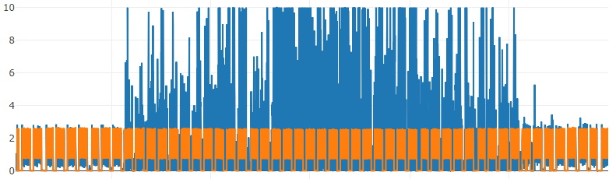
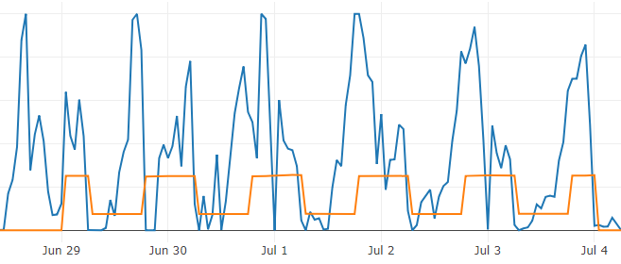
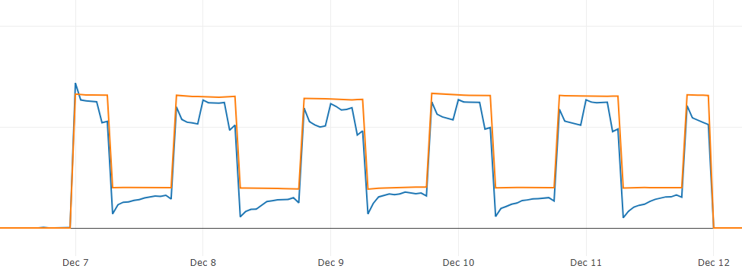
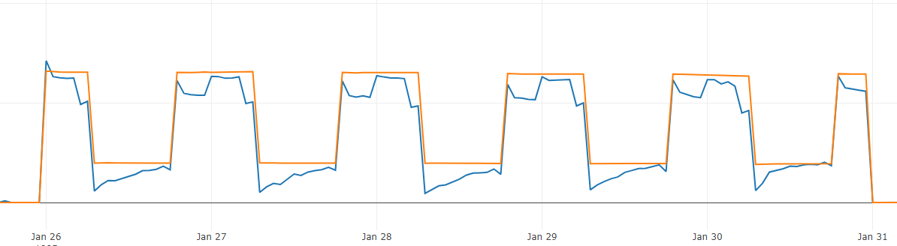
Hybrid Calibration – air infiltration
Example of zone air infiltration schedule.
The inversely solved zone air infiltration rate (with measured air temperature) aligns with the ground truth well in heating seasons, but they don’t match in cooling seasons.
Possible reason: air infiltration is sensitive to the external and internal interference. For example, the zone surface heat transfer has big impact on the zone air heat balance equation.
Annual
A week in July
Inverse Solution
A week in January
A week in December
Ground Truth
* The plot shows the number people schedule in a perimeter zone (zone back) of a typical week.

Slide 32
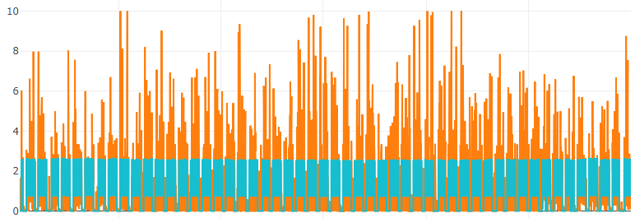



Hybrid Calibration – air infiltration
Example of zone air infiltration schedule.
The inversely solved zone air infiltration rate (with measured air humidity ratio) has lots of spike
The inverse solution aligns with the ground truth better in heating seasons
Annual
A week in January
A week in July
A week in December
Inverse Solution
Ground Truth
* The plot shows the number people schedule in a perimeter zone (zone back) of a typical week.

Slide 33




Hybrid Calibration – air infiltration
Example of zone air infiltration schedule.
The inversely solved zone air infiltration rate (with measured air CO₂ concentration) has lots of spike
The inverse solution follows the ground truth at beginning of each day, but has big oscillations.
Annual
A week in January
A week in July
A week in December
Inverse Solution
Ground Truth
* The plot shows the number people schedule in a perimeter zone (zone back) of a typical week.

Slide 34


Hybrid Calibration – air infiltration
Gains of the inversely solved people count in model calibration
No accuracy gains from applying the inverse solution of air infiltration rate
 | Inverse People Count Schedule | NMBE | CV(EMSE)
Electricity | No | 1.9% | 1.9%
 | yes | 1.1% | 2.7%
Natural Gas | No | 2.7% | 3.0%
 | yes | 22.0% | 29.6%
Monthly Level
* The calibrating model uses the inversely solved (with measured air temperature) air infiltration rate schedule

Slide 35

Hybrid Calibration – Discussions
Critical: When to use inverse modeling?
Use it in early steps:
Building and system characteristics are highly uncertain, the inverse solution is meaningless.
The uncertainty of the inverse solution is huge.
Use it in late steps:
The inverse solution is more reliable.
The benefit to monthly calibration precision is marginal.
It benefits more in terms of calibration with high resolution (e.g., hourly, daily)

Slide 36
Hybrid Calibration – Conclusions
1. The inverse modeling techniques should be applied to a relatively accurate model (with some initial calibrations) to avoid uncertain solutions.
2. The benefit of inversely solved people count in the calibration at monthly level is insignificant because of the oscillations are flattened at monthly aggregations.
3. The inversely solved people count can improve the model calibration accuracy more at hourly level.
4. The inversely solved air infiltration is more sensitive to the uncertainties of other parameters. The inverse solution doesn’t bring accuracy gain in the model calibration. Future investigations are needed for improvements.

